Slide 1
Understanding Economics and How It Affects Business
TAKMILLA TABASSUM

Slide 2
Topics to be Covered
The major branches of economics
Resource development
Key Economic Indicators
The Invisible Hand Theory
Free market Capitalism, foundations of capitalism, Socialism and Communism
The Trend Towards Mixed Economies
Competition within Free Markets
Demand and its determinants
Supply and its determinants
Equilibrium, shortage and surplus

Slide 3
The Major Branches of Economics
Economics:
The study of how society employs resources to produce goods and services and distribute them for consumption among various competing groups and individuals.
It is the science of scarcity.
Macroeconomics: The branch of economics that focuses on the operation of a nation’s economy as a whole.
Microeconomics: The branch of economics that focuses on the behavior of people and organizations in markets for particular products or services.

Slide 4
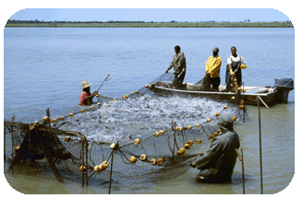
Resource Development
Resource Development: The study of how to increase resources and create conditions that will make better use of those resources.
New energy sources (hydrogen fuel for autos)
New ways of growing food (hydroponic)
New ways of creating needed goods and services (mariculture and nanotechnology).

Slide 5
Key Economic Indicators
GDP: The total value of final goods and services produced in a country in a given year.
Unemployment Rate: The percentage of civilians at least 16 years old who are unemployed and tried to find a job within the prior four weeks. Types of unemployment include frictional, structural, cyclical and seasonal.

Slide 6
GDP (continued)
Included in GDP:
Final goods and services sold for money.
Not included in GDP:
unpaid work: work performed within the family, volunteer work, etc.
goods not produced for sale in the marketplace
bartered goods and services
black market
illegal activities
sales of used goods
intermediate goods and services that are used to produce other final goods and services

Slide 7
Key economic indicators
Inflation is a general rise in the prices of goods and services over time.
Deflation means that prices are declining; It occurs when countries produce so many goods that people cannot afford to buy them all.
Recession: Two or more consecutive quarters of decline in the GDP.

Slide 8
The Business Cycle
Business cycles are the periodic rises and falls that occur in economies over time.
The four phases of long-term business cycles are:
1. An economic boom is business is booming.
2. Recession is two or more consecutive quarters of decline in the GDP.
3. A depression is a severe recession, usually accompanied by deflation.
4. A recovery occurs when the economy stabilizes and starts to grow. This eventually leads to an economic boom, starting the cycle all over again.

Slide 9
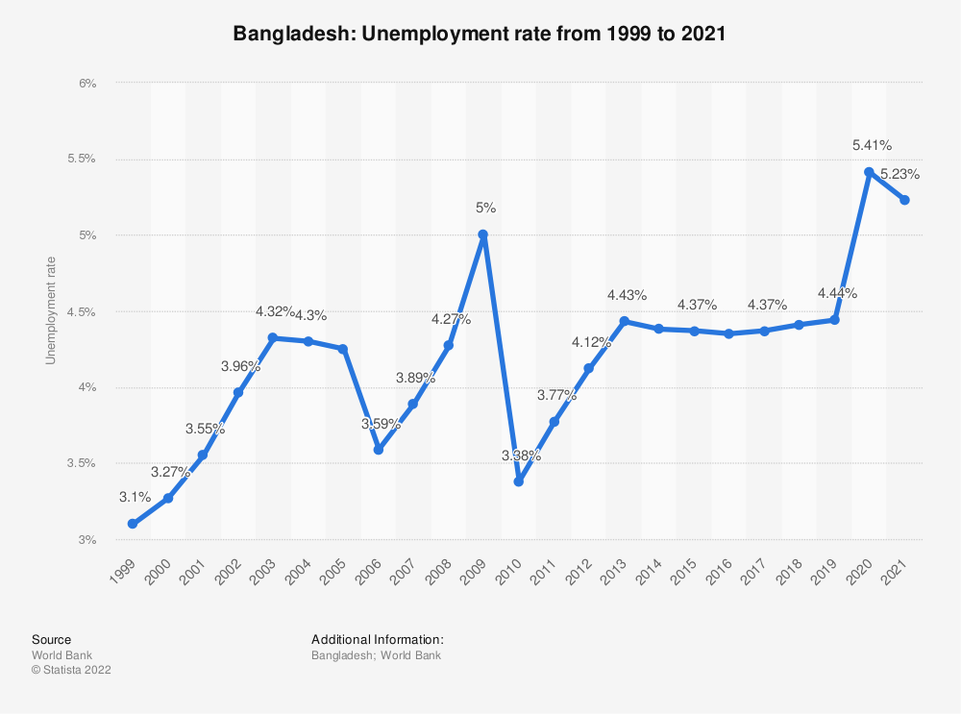
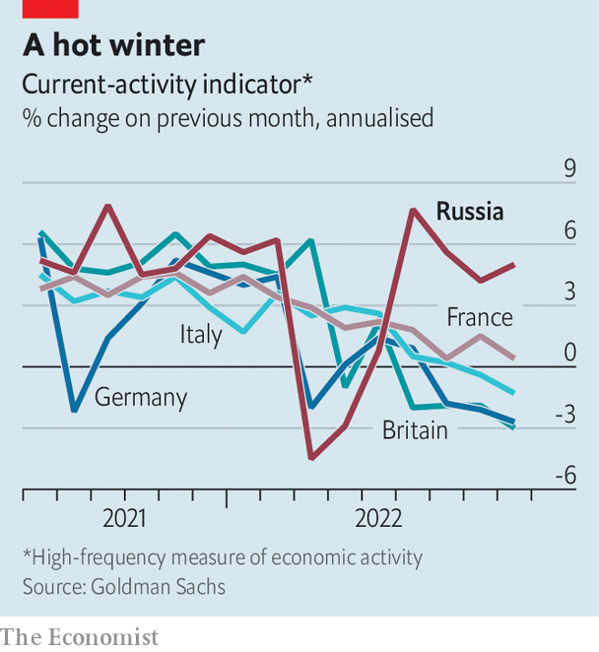
Key Economic Indicators (continued)

Slide 10
Macroeconomic policy objectives
The four key macroeconomic policy objectives:
Low Inflation
Low unemployment
Stable economic growth
A good current account and capital account position
Monetary Policy: **An economic policy whereby the Central bank controls the money supply, strategically changes the interest rate, manages inflation, unemployment and maintains currency exchange rates.
Fiscal Policy: Government Policy whereby Government aims to achieve its objectives through government expenditure and taxation.

Slide 11
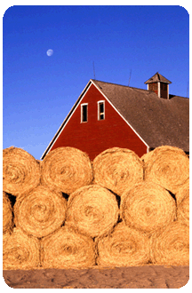
The Invisible Hand Theory
Invisible Hand: A phrase coined by Adam Smith to describe the process that turns self-directed gain into social and economic benefits for all.

Slide 12
Free market Capitalism
Free market: A free market is one in which decisions about what and how much to produce are made by the market.
Capitalism: An economic system in which all or most of the factors of production and distribution are privately owned and operated for profit.
Foundations of Capitalism:
The right to own private property.
The right to own a business and keep all that business’ profits.
The right to freedom of competition.
The right to freedom of choice.

Slide 13
Socialism and Communism
Socialism: An economic system based on the premise that some, if not most, basic businesses should be owned by the government so that profits can be more evenly distributed among the people.
Communism: An economic and political system in which the government makes almost all economic decisions and owns almost all the major factors of production.

Slide 14
The Trend Towards Mixed Economies
Free-market economies exist when the market largely determines what goods and services get produced, who gets them, and how the economy grows.
Command economies exist when the government largely decides what goods and services will be produced, who gets them, and how the economy will grow.
Mixed economies have economic systems in which some allocation of resources is made by the market and some by the government. Most countries don’t have a name for such a system. If free-market mechanisms allocate most resources, the leaders call their system capitalism. If the government allocates most resources, the leaders call it socialism.

Slide 15
Competition within Free Markets
Monopoly: The single seller sells a product for which there are no close substitutes. In the United States, laws prohibit the creation of monopolies.
Oligopoly: A degree of competition in which just a few sellers dominate the market.
Perfect competition: It exists when there are many sellers in a market, and none is large enough to dictate the price of a product.
Monopolistic competition: It exists when there are many sellers producing very similar products that buyers nevertheless perceive as different,

Slide 16
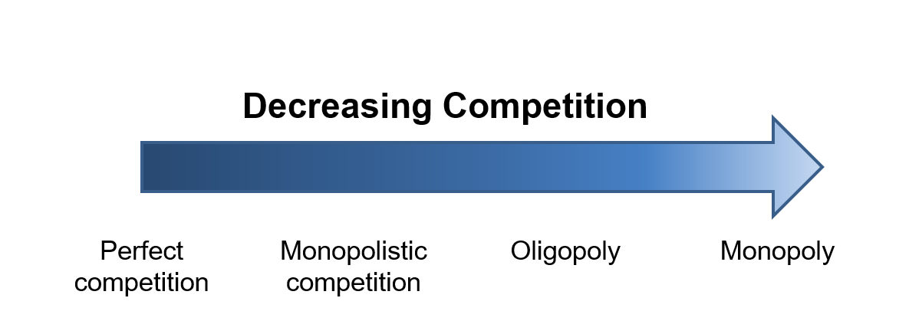

Slide 17
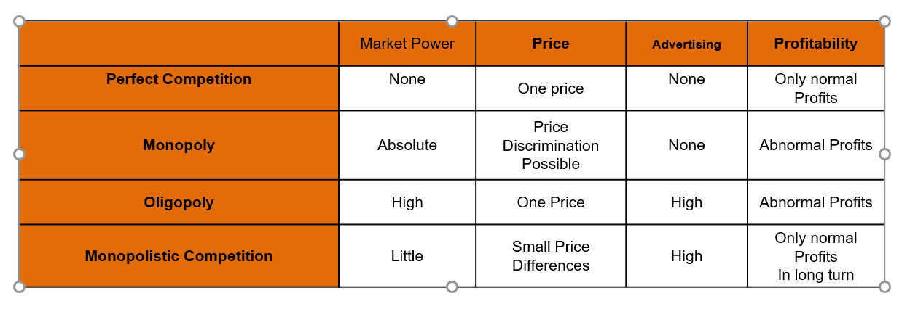
Implications of Theory for Behaviour of firms

Slide 18
Demand
Demand: The willingness and ability of buyers to purchase different quantities of a good at different prices during a specific period of time.
Law of Demand: The law of demand states that the price of a good and the quantity demanded of the good are inversely related, ceteris paribus.
Change in quantity demanded occurs when there is a change in price.
Change in demand occurs when a factor other than price affects the quantity demanded.

Slide 19
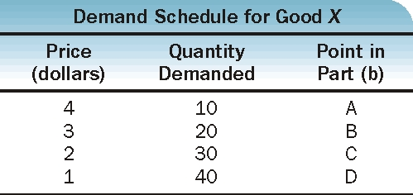
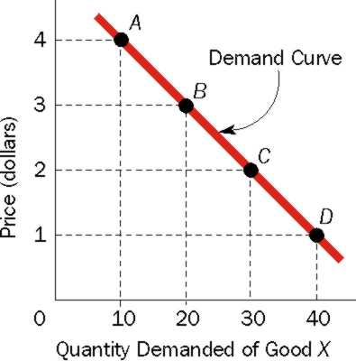
Demand (continued)
(a)
(b)

Slide 20
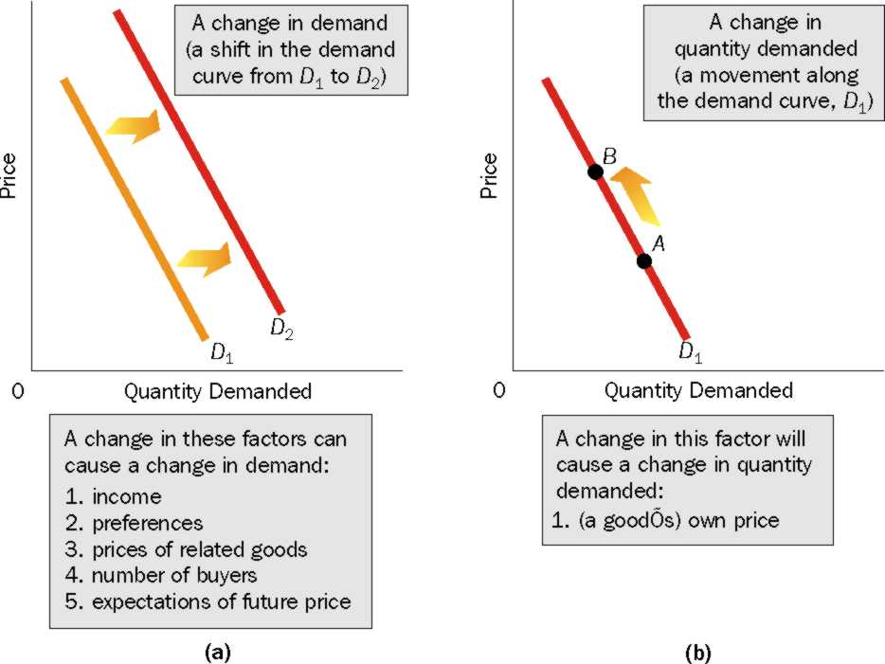
Demand (continued)

Slide 21
Factors affecting Demand
Income: As a person’s income changes (increases or decreases), his or her demand for a particular good may rise, fall or remain constant.
Normal goods
Inferior goods
Neutral goods
Preferences: Change in preferences in favor of the good increases demand for the good (ceteris paribus); change in preferences away from the good decreases demand ceteris paribus
Number of buyers: The number of buyers might increase due to a higher birth rate, increased migration, etc.; if the number of buyers increases then demand will increase

Slide 22
Factors affecting Demand (continued)
Prices of related goods:
Substitute goods satisfy similar needs. If two goods are substitutes, the demand for one good increases as the price of the other good rises.
Complements are consumed together. If two goods are complements, the demand for one rises as the price of the other falls.
Expectations of future price: If buyers expect the price to increase in the future, then the current demand will increase. If we expect that the price of rice might increase in the future, then we are likely to purchase rice now and store them for future use

Slide 23
Supply
Supply: The willingness and ability of sellers to produce and offer to sell different quantities of a good at different prices during a specific period of time.
Law of Supply: The law of supply states that the price of a good and the quantity supplied of the good are directly related, ceteris paribus
Change in quantity supplied occurs when there is a change in the market price of the product
Change in supply is caused by a determinant other than the price

Slide 24
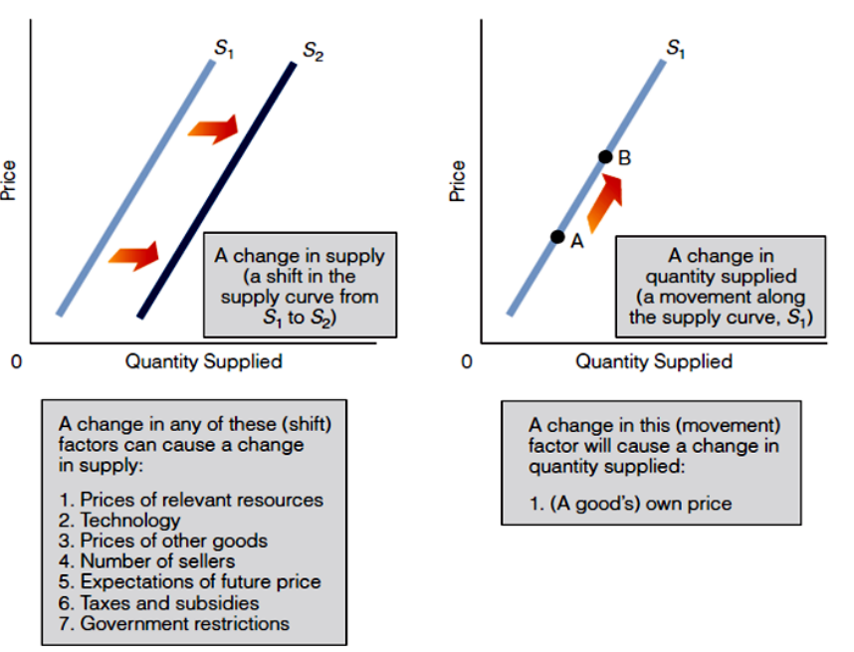
Supply (continued)

Slide 25
Factors affecting Supply
Input prices: For example, ice-cream
Technology: Due to technological improvement the same output can be produced using fewer resources so the cost of production decreases. Technological advancement can increase supply.
Expectations of future prices: If a seller expects the price of the goods being sold will increase in the future, then instead of selling the goods now, the seller is likely to sell the goods in the future.
Number of Sellers: If the number of sellers falls, then supply will also fall.

Slide 26
Equilibrium
Equilibrium point: The equilibrium point (E) is where the demand and supply curves meet (i.e. Qd =Qs).
Equilibrium price: The price that balances demand and supply.
Equilibrium quantity: The quantity that balances demand and supply.

Slide 27
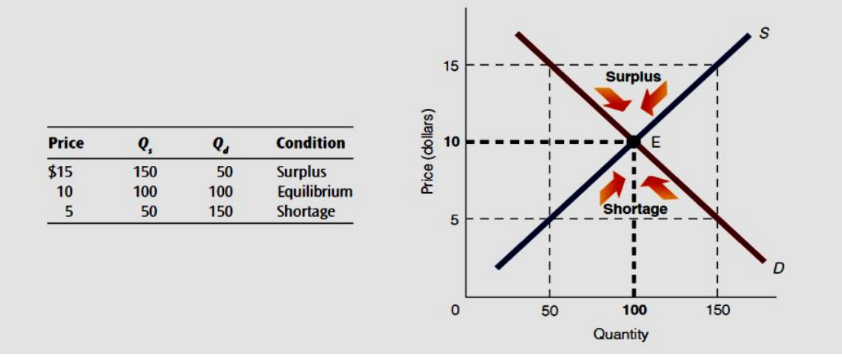
Equilibrium (continued)

Slide 28
References
Arnold, R. A. (2014) Macroeconomics (11th ed.). South-Western.
Mankiw, N.G. (2018) Principles of Microeconomics (8th ed.). Cengage Learning.
Nickels, W. G., McHugh, J. M. & McHugh, S. (2014) Understanding Business (11th ed.). McGraw-Hill.

Slide 29
Thank you

Slide 30
It is not from the benevolence of the butcher, the brewer, or the baker that we expect our dinner, but from their regard for their own interest. -Adam Smith When men are employed they are best contented. - Benjamin Franklin

